Slide 1


Slide 2


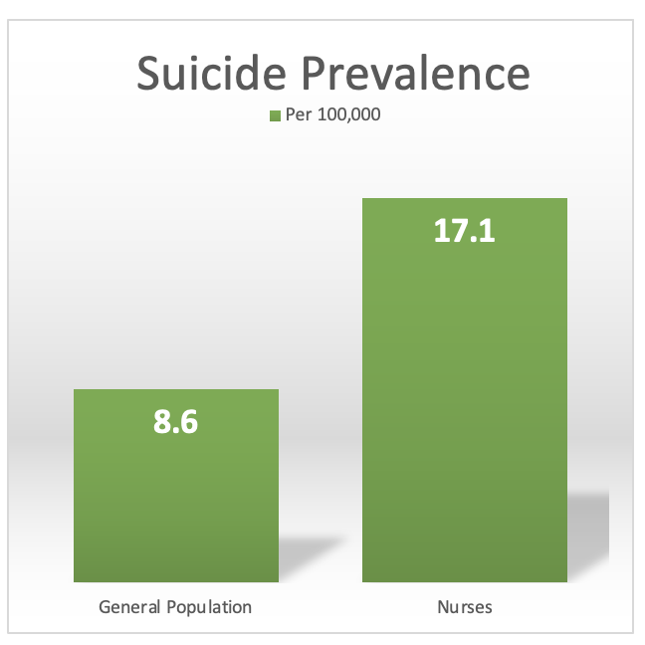
Sara's Story
Nurses are not a disposable commodity
18% of nurses report depression
63% of nurses report burnout
50% of nurses report bullying
5
6
Notes:
JENNIFER
Sara was a recent graduate from my nursing program. She excelled throughout. Six-months post-graduation Sara began reaching out to faculty to discuss the issues of incivility and non-support she was experiencing at work. We all tried to do better for Sarah to improve her transition. Tragically, a year after Sara graduated and began what she had hoped would be her dream job, we received the horrible news that she took her own life. The elephant in the room for practice that we can no longer ignore is that many nurses like Sara are choosing to leave nursing due to mental health issues related to a lack of belonging and/or nurse on nurse bullying.
It is our hope to honor the Sara’s in our profession by providing earlier support structures such as specialized appRNticeship tracks. Instead of eating our young, we propose innovative practice partnerships to help mold and feed our future, mutually fill each other’s cups, and train a more engaged and healthier workforce for a more sustainable tomorrow.

Slide 3
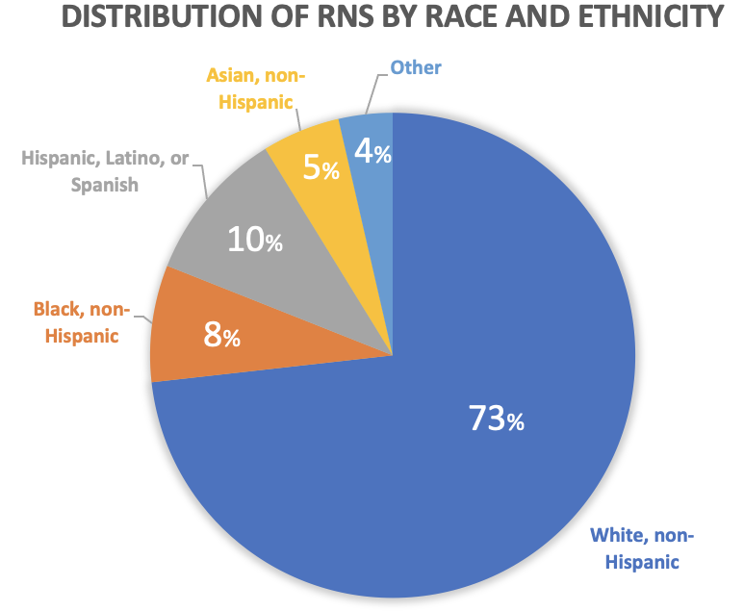


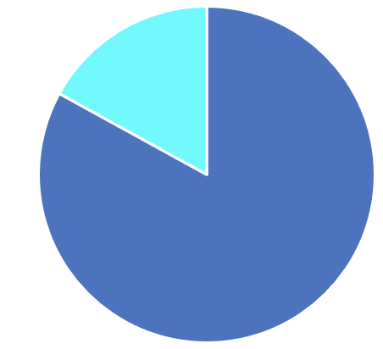
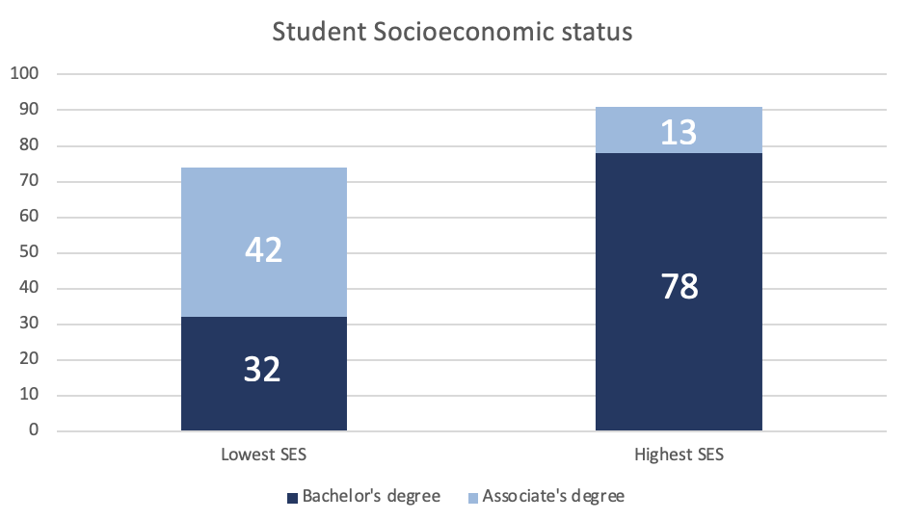
Building Retention
Supporting Diversity
2
1 in 4
1
4
Of all new hire nurses leave within a year
1
:
10
83%
are nurses with less than one year of service
1
3
Let’s get into that…
U.S. turnover = 18.7%¹
Estimated costs $3.6 – $6.5 million per hospital per year¹
%
Notes:
JENNIFER
“The data is clear, in nursing that when 1 in 4 new hires leave within a year, we need to build retention. And when 73% of nurses are White and non-Hispanic -- we need to support diversity across ALL practice settings.”

Slide 4

Nursing Education & Transition-to-Practice (TTP) (2-year ADN program)
 | Academic Program |  |  |  | Graduation and TTP Internships/externships |  |  |  | New Hire
 | Year 1 Sem 1 | Year 1 Sem 2 | Year 2 Sem 1 | Year 2 Sem 2 | Week 1-2 | Week 2-4 | Week 4-6 | Week 6-8 | 90 days | 1 year | 18 mo | 2 years
Didactic
Clinical Rotations
Identifying Your Passions
Clinical Experience matched to Passion
Interviews
Boards
New Hire Orientation
MISSING
Notes:
JENNIFER
Image of wolf
In nursing, we tend to throw new nurses to the wolves and pray for the best!
click NEXT button – shows the chart
Let’s consider a traditional 2 year ADN program, as students identify their passions, that connection, highlighted in PINK, may or may NOT happen during their educational program
So what happens when they go for interviews? What happens when they pick that first job? What happens as that GAP between passion and practice continues to widen?
Pitch to Michelle
So, hey Michlele, let’s talk about a solution!

Slide 5
Solution:
Increase nurse satisfaction/ retention
Decrease hospital admissions
Decrease ER visits
Increase diversity in the workforce
Reduce costs in replacing nursing staff
INTEGRATED into nursing school curriculum
PAID
apprentice & coach
ALL
practice
settings
Notes:
MICHELLE
Solution:
In response to nursing turnover and a NEED to increase new to practice nurses’ sense of belonging, our team proposes the appRNticeship
appRNticeship is an innovative academic-practice partnership program that targets nursing retention and diversity through the purposeful integration of paid, 1:1, apprenticeships during academic preparation
A successful appRNticeship pilot will result in...
-Increased nurse satisfaction
-Increase diversity in the workforce
-reduce costs in replacing nursing staff
-decrease ER visits
-decrease hospital admissions
Cost analysis:
Based off of a 40 hour/wk schedule
$15/hour for apprentice ($600/week x 16wks) = $9,600 per apprentice x 10 = $96,000
$5/hour differential for coach = ($200/week x 16wks) = $3,200 per coach x 10 = $32,000 = $128,000
“Employees’ sense of purpose directly affects turnover… a 10% improvement in employees’ connection with the mission or purpose of their organization can result in an 8.1% decrease in turnover”
8% reduction in turnover could save 288,000 – 520,000 per year per hospital
Savings of $160k – $390k per year just for nurse retention (does not include onboarding or residency costs) good trial period to determine if facility is a good fit
Investing in your nurses will lead to better patient outcomes and higher reimbursement rates

Slide 6
appRNticeship vs. existing clinical training programs
 | appRNticeship | Traditional Internships | Nurse Residency Programs | Traditional Externships | New Hire Orientation
Pre-Graduation
All academic programs
Paid: apprentice & coach
1 Apprentice : 1 Coach
Connectedness Sense of Belonging
Community Health Practice Settings
Notes:
MICHELLE
This is how appRNticeship differs from existing clinical training programs
As you can see, none of the existing programs meet ALL core components of apprnticeship
Notes for questions --
Internships – purpose to gain experience and move on
NRP – acute care settings only; BSN mostly
EDUCATION
Traditional Clinical Education
Complete hours in practice for hands-on career-based learning (experiences variable)
Lab/Simulation practice to attempt to increase hands-on/realism
Capstone Practicums
Typical focused practice rotation in last semester
Student/Nurse experiences vary
Generalist Education
Focus on multiple practice areas for beginners
Med/Surg, OB/Peds, Community Health, Mental Health, Complex Care
Work-based Preparation & Coping Strategies
Soft skills
Critical conversations, self-care, and professionalism
PRACTICE
Orientation Programs & Incentives
Extreme variability
Money and tuition reimbursement are nice, but loving your work makes people want to stay
Preceptorships
May be no incentive other than giving back to practice from burnout/ overworked preceptors
Externships/Internships-expanded student roles
Glorified Nurse Aid roles with pay variability
Difficult for students to find life, school, and work balance
Does not count towards clinical hour completion
Unstructured Residencies
Varies from weeks to months
Sometimes poor support and bad mentor matches

Slide 7
Scalability
Pilot Stakeholders
Federally Qualified Health Centers (FQHCs)
ADN/ BSN schools
RN students
Secondary Stakeholders
FQHCs
ADN/ BSN/ APRN schools
RN/ APRN students
Insurers
Tertiary Stakeholders
FQHCs
ADN/ BSN/ APRN schools
RN/ APRN students
CMS
Labor Department grant
Value-based payment model
Hospitals
Hospitals
Notes:
MICHELLE
“We acknowledge that our key stakeholders will GROW in stages as appRNticeship shows strength”
Once a proof-of-concept is established, (i.e. increased nurse retention, reduced ER visits and hospital admissions) insurers and hospitals will acknowledge the cost benefit and invest to maintain the appRNticeship program
The appRNticeship program can be scaled to include the acute care setting and APRN transition-to-practice
May seek CMS funding which currently funds medical residencies

Slide 8
Scalability
Sustained Partnerships
FQHCs
Nursing schools
Data and Analytics
Analyze quality indicators
Marketing
Manage the messaging through first-hand accounts
Data will demonstrate proof-of-concept
Notes:
MICHELLE
AppRNticeship success is dependent upon sustained partnerships, data and analytics, and marketing
In honor of Sara, instead of eating our young, we will instead feed them -
appRNticeship an innovative solution to diversifying, training and retaining RNs -

Slide 9
The appRNticeship Team
Michelle A. Abeyta, MSN, APRN
michelle@rnnovations.com
Co-founder/Director of Nursing RNNovations
Jennifer Blanchard, DNP, MSN, RNCWON
Jennifer.Blanchard@araphoe.edu
Director of Nursing, Araphoe Community College
Celena Chavez
cchav0809@365.Elmhurst.edu
Student Nurse, Elmhurst University
Ghafar Kurdieh, MSN, RN, MEDSURG-BC, NPD-BC
gkur100@dchweb.org
Clinical Education Specialist, Luminis Health
Beth Froh, PhD, RN
frohe@chop.edu
Nurse Scientist, Children’s Hospital of Philadelphia
Adjunct Assistant Professor, University of Pennsylvania
Jessica Lamberson, DNP, RNC-OB, CNL
Jessica.lamberson@elmhurst.edu
Assistant Professor, Elmhurst University
Juan Pablo Garcia jgarc7182@365.Elmhurst.edu
Student Nurse,
Elmhurst University
Sharon Ellis, Med, BSN, RN
Sharon.ellis@vizientsouthernstates.com
Senior Director Clinical Improvement Vizient Southern States

Slide 10
References
1. NSI Nursing Solutions (2021). 2021 NSI national health care retention & RN staffing report. Retrieved from https://www.nsinursingsolutions.com/Documents/Library/NSI_National_Health _Care_Retention_Report.pdf
2. Health Resources and Services Administration. (2019). 2018 national sample survey of registered nurses: Brief summary of results. Retrieved from https:// bhw.hrsa.gov/sites/default/files/bureau-health-workforce/data-research/ nssrn-summary-report.pdf
3. National Center for Education Statistics (2019). Young adult educational and employment outcomes by family socioeconomic status. Retrieved from https://nces.ed.gov/ programs/coe/pdf/coe_tbe.pdf
4. Smiley, R. A., Ruttinger, C., Oliveira, C. M., Hudson, L. R., Allgeyer, R., Reneau, K. A., Silvestre, J. H., & Alexander, M. (2021). The 2020 national nursing workforce survey. Journal of Nursing Regulation, 12(1), S1-S96. https://doi.org/10.1016/S2155-8256(21)00027-2.
5. Threw (2019). Avoiding nursing burnout: Key takeaways. Retrieved from https://www.myamericannurse.com/promoting-nurse-mental-health/
6. Davis et al., (2020). Associate of US nurse and physician occupation with risk of suicide. JAMA Psychiatry.https://jamanetwork.com/journals/jamapsychiatry/article-abstract/2778209
Notes:
Smiley, R. A., Ruttinger, C., Oliveira, C. M., Hudson, L. R., Allgeyer, R., Reneau, K. A., Silvestre, J. H., & Alexander, M. (2021). The 2020 national nursing workforce survey. Journal of Nursing Regulation, 12(1), S1-S96. https://doi.org/10.1016/S2155-8256(21)00027-2.

Slide 11


